Slide 1

Personality Prediction
Using Random Forest

Slide 2
Architecture
1
User Input
Random Regressor
Streamlit
4
2
Output
3

Slide 3
Code For Random Forest
import pandas as pd
import numpy as np
from sklearn.model_selection import train_test_split
from sklearn import preprocessing
from sklearn.preprocessing import StandardScaler
from sklearn.impute import SimpleImputer
from sklearn.ensemble import RandomForestClassifier
from sklearn import metrics
1
# Load the dataset
file_path = 'train.csv'
df = pd.read_csv(file_path)

Slide 4
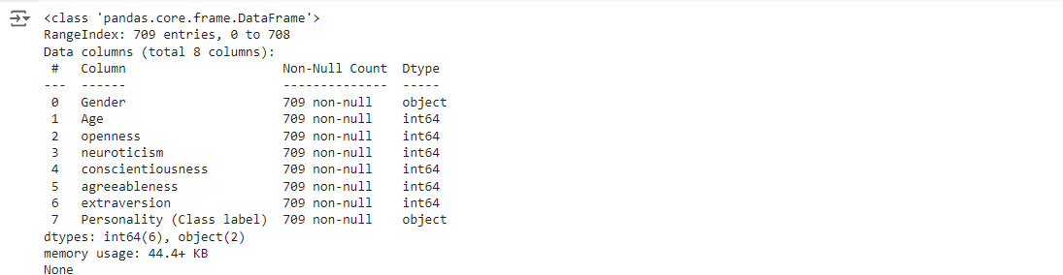
Code For Random Forest
# Display basic information about the dataset
print(df.info())
print(df.head())
Output
1

Slide 5
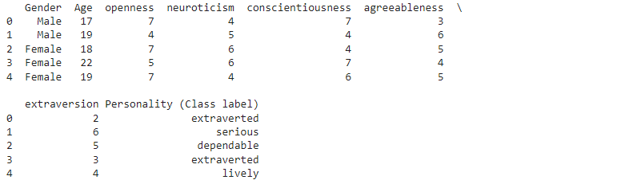
Code For Random Forest
# Display basic information about the dataset
print(df.info())
print(df.head())
Output
1

Slide 6
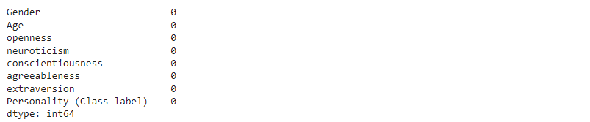
Code For Random Forest
# Check for missing values
print(df.isnull().sum())
Output
1

Slide 7
Code For Random Forest
# Encode categorical variables
le = preprocessing.LabelEncoder()
df['Personality (Class label)'] = le.fit_transform(df['Personality (Class label)'])
df['Gender'] = le.fit_transform(df['Gender’])
# Separate features and target
x = df.drop('Personality (Class label)', axis="columns")
y = df['Personality (Class label)']
print("Shape of independent variables x:", x.shape)
print("Shape of dependent variable y:", y.shape)
1
Output
Shape of independent variables x: (709, 7) Shape of dependent variable y: (709,)

Slide 8
Code For Random Forest
# Split the data
x_train, x_test, y_train, y_test = train_test_split(x, y, test_size=0.2, random_state=2)
print("Shape of x_train:", x_train.shape)
print("Shape of y_train:", y_train.shape)
print("Shape of x_test:", x_test.shape)
print("Shape of y_test:", y_test.shape)
1
Output
Shape of x_train: (567, 7)
Shape of y_train: (567,)
Shape of x_test: (142, 7)
Shape of y_test: (142,)

Slide 9
Code For Random Forest
# Handle missing values using SimpleImputer
imputer = SimpleImputer(strategy='mean')
x_train_imputed = imputer.fit_transform(x_train)
x_test_imputed = imputer.transform(x_test)
# Standardize the features
scaler = StandardScaler()
x_train_scaled = scaler.fit_transform(x_train_imputed)
x_test_scaled = scaler.transform(x_test_imputed)
# Train the RandomForestClassifier
rf = RandomForestClassifier(n_estimators=10, criterion="entropy", random_state=5)
rf.fit(x_train_scaled, y_train)
1
Output

Slide 10
Code For Random Forest
# Make predictions
y_pred = rf.predict(x_test_scaled)
# Evaluate the model
accuracy = metrics.accuracy_score(y_test, y_pred)
print(f"Accuracy: {accuracy:.4f}")
1
Output
Accuracy: 0.9465

Slide 11
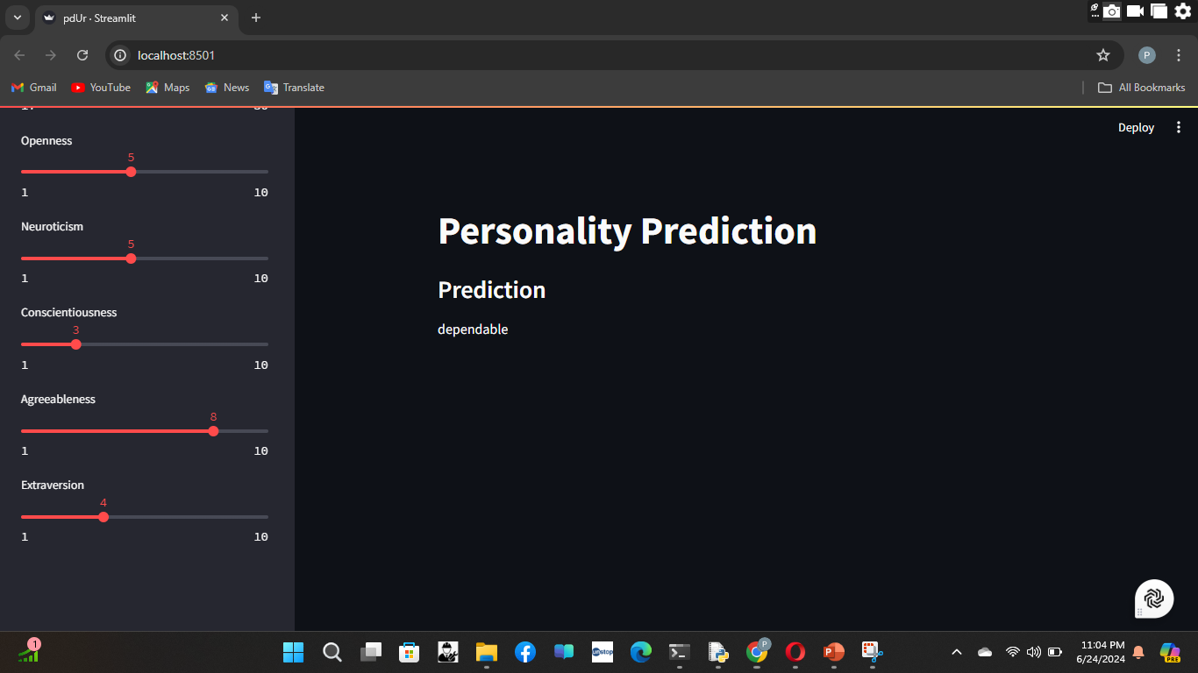
Implementing Random Forest : Website Overview
1

Slide 12
Implementing Random Forest
import streamlit as st
import pandas as pd
import numpy as np
from sklearn.ensemble import RandomForestClassifier
# Load the dataset
data = pd.read_csv('train.csv')
# Preprocess the data
data['Gender'] = data['Gender'].map({'Male': 1, 'Female': 0})
# Features and target variable
X = data[['Gender', 'Age', 'openness', 'neuroticism', 'conscientiousness', 'agreeableness', 'extraversion']]
y = data['Personality (Class label)']
# Train a simple model (Random Forest Classifier)
model = RandomForestClassifier()
model.fit(X, y)
# Streamlit app
st.title('Personality Prediction')
st.sidebar.header('User Input Parameters')
1

Slide 13
Implementing Random Forest
def user_input_features():
gender = st.sidebar.selectbox('Gender', ('Male', 'Female'))
age = st.sidebar.slider('Age', 17, 30, 19)
openness = st.sidebar.slider('Openness', 1, 10, 5)
neuroticism = st.sidebar.slider('Neuroticism', 1, 10, 5)
conscientiousness = st.sidebar.slider('Conscientiousness', 1, 10, 5)
agreeableness = st.sidebar.slider('Agreeableness', 1, 10, 5)
extraversion = st.sidebar.slider('Extraversion', 1, 10, 5)
gender = 1 if gender == 'Male' else 0
data = {
'Gender': gender,
'Age': age,
'openness': openness,
'neuroticism': neuroticism,
'conscientiousness': conscientiousness,
'agreeableness': agreeableness,
'extraversion': extraversion
}
1

Slide 14
Implementing Random Forest
features = pd.DataFrame(data, index=[0])
return features
input_df = user_input_features()
# Prediction
prediction = model.predict(input_df)
st.subheader('Prediction')
st.write(prediction[0])
1

Slide 15
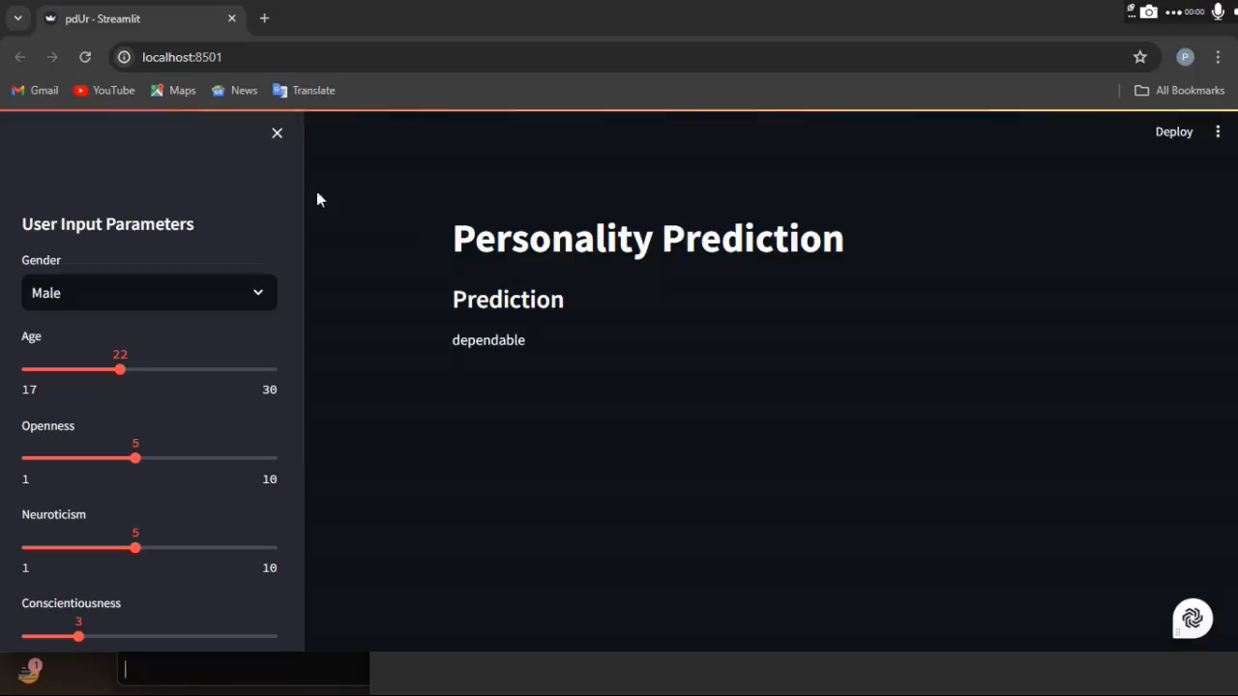
Output Video

